Slide 1
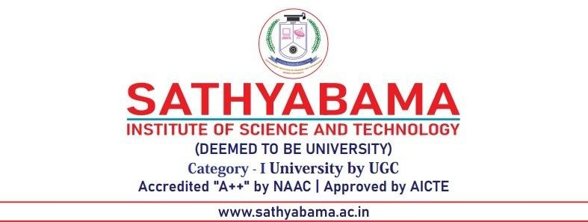
DEPARTMENT OF COMPUTER SCIENCE AND ENGINEERING
INTERDISCIPLINARY PROJECT
SMART INDUSTRIAL MAINTENANCE SYSTEM (SIMS) USING GEN AI WITH MULTIMODAL AGENTIC ARCHITECTURE
PROJECT STUDENT GUIDE
Karthik Sriram S, 43110423 Dr.C.Hemalatha, M.E., Ph.D.,
Assistant Professor, CSE

Slide 2
AGENDA
Certificate
Introduction
Abstract
Objective
System Architecture / Ideation Map
Module Implementation
Results and Discussions
Conclusion
References

Slide 3
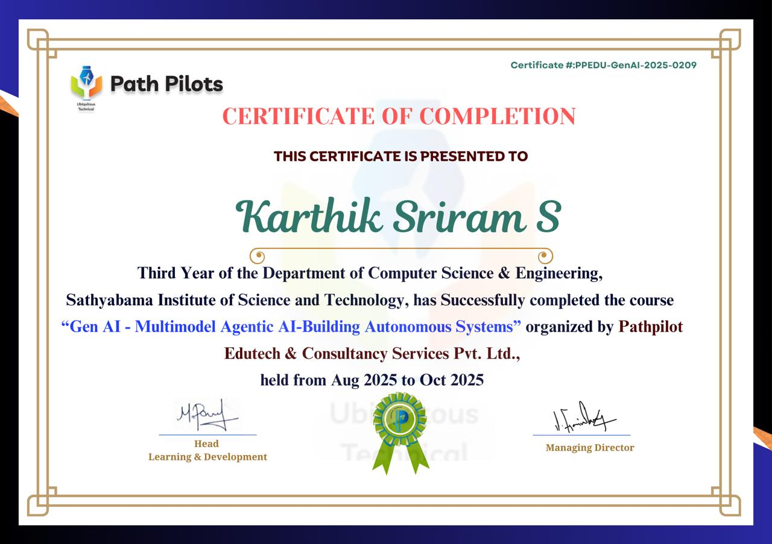
COURSE CERTIFICATE

Slide 4
INTRODUCTION
In the era of Industry 4.0, the integration of Generative AI with Multimodal Agentic Architectures is revolutionizing industrial maintenance. The Smart Industrial Maintenance System (SIMS) leverages these advanced technologies to enhance operational efficiency, reduce downtime, and optimize maintenance strategies.

Slide 5
ABSTRACT
The Smart Industrial Maintenance System (SIMS) represents a transformative approach to industrial asset management by integrating Generative AI with a Multimodal Agentic Architecture. This innovative framework enables autonomous agents to process and interpret diverse data streams—such as sensor readings, acoustic signals, and visual inputs—facilitating real-time diagnostics and predictive maintenance. The system's agentic design allows for decentralized decision-making, enhancing scalability and adaptability across various industrial environments.

Slide 6
OBJECTIVE
Predictive Maintenance: Leverage Generative AI to forecast equipment failures, enabling timely interventions and reducing unplanned downtime.
Multimodal Data Integration: Integrate diverse data sources—including IoT sensors, acoustic signals, and visual inputs—to provide a comprehensive understanding of equipment health.
Autonomous Decision-Making: Develop intelligent agents capable of making real-time maintenance decisions, optimizing workflows, and enhancing operational efficiency.
Scalability and Flexibility: Design the system architecture to be scalable and adaptable, accommodating the evolving needs of various industrial environments.

Slide 7
SYSTEM ARCHITECTURE/IDEATION MAP
Generative AI Models: Analyze data to predict failures.
Machine Learning Algorithms: Classify anomalies and assess equipment health.
Autonomous Agents: Make real-time maintenance decisions.
Collaborative Agents: Coordinate tasks across systems.
Dashboards: Provide real-time monitoring and alerts.
Mobile Interfaces: Allow field technicians to receive instructions.
Cloud & Infrastructure Layer
Cloud Storage: Store large volumes of data securely.
Computational Resources: Support AI model training and inference.

Slide 8
MODULE IMPLEMENTATION
1. Data Acquisition
Deploy IoT sensors, cameras, and acoustic devices to collect real-time operational data.
2. Data Processing & Fusion
Utilize edge computing for initial data processing.
Integrate multimodal data streams (sensor, visual, acoustic) for comprehensive analysis.
3. AI & Analytics
Implement Generative AI models for predictive maintenance.
Apply machine learning algorithms for anomaly detection and health assessment.
4. Agentic Decision-Making
Develop autonomous agents for real-time diagnostics and maintenance scheduling.
Enable collaborative agents for task coordination and optimization.

Slide 9
RESULT AND DISCUSSION
Enhanced Predictive Maintenance - SIMS leverages multimodal data—sensor readings, acoustic signals, and visual inputs—processed by Generative AI to predict equipment failures with high accuracy. This approach enables proactive maintenance, reducing downtime and extending asset life.
Seamless Human-Machine Collaboration - The integration of multimodal inputs allows SIMS to interpret complex scenarios, facilitating intuitive interactions between human operators and AI agents. This collaboration enhances operational efficiency and safety.
Scalability and Adaptability - Designed to function across diverse industrial environments, SIMS demonstrates scalability and adaptability. Its architecture supports integration with existing systems, ensuring broad applicability and future-proofing.

Slide 10
CONCLUSION
Autonomous Optimization: SIMS empowers industrial operations to transition from reactive to proactive maintenance, enhancing efficiency and reducing downtime.
Enhanced Decision-Making: By integrating multimodal data, SIMS provides comprehensive insights, facilitating informed and timely decisions.
Scalability and Adaptability: Designed to seamlessly integrate with existing infrastructures, SIMS offers scalable solutions adaptable to various industrial environments.
Strategic Advantage: Implementing SIMS positions organizations at the forefront of Industry 4.0, driving innovation and maintaining competitiveness.

Slide 11
REFERENCES
N. S. Gill, "How to Build Agentic AI for Industrial Systems,“
EE Journal, "Agentic AI Prevents Costly Machine Downtime in Factories and Semiconductor Fabs,"
Sensfix, “A Multi-Modal AI Agent for Facilities Maintenance,"
Dataiku, "AI Agents: Setting the Bar for Manufacturing Maintenance”
RT Insights, "How Agentic AI Is Powering the Next Industrial Uptime Revolution,"

Slide 12
THANK YOU
We thank God, Our Department, Guide, Panel Members, Supportive Professors and all Technical and non Technical staff who helped us in our Project.

